Slide 1
The difference between NoSQL and SQL

Slide 2
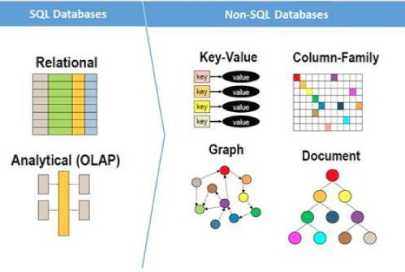
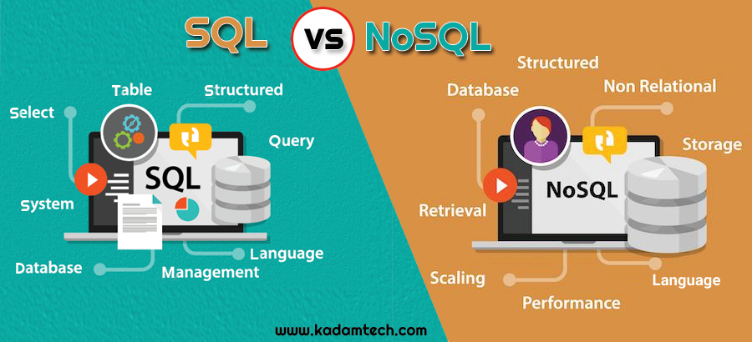

Slide 3
SQL vs NoSQL: Main Differences
SQL is the programming language used to interface with relational databases. (Relational databases model data as records in rows and tables with logical links between them). NoSQL is a class of DBMs that are non-relational and generally do not use SQL. There are five practical differences between SQL and NoSQL:
Language
Scalability
Structure
Properties
Support and communities

Slide 4
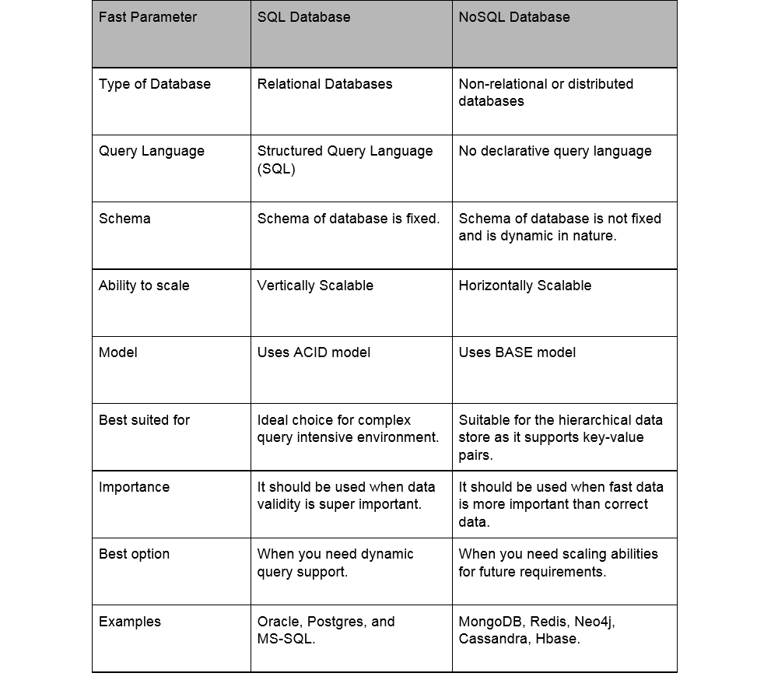


Impressionnez votre auditoire

